Slide 1
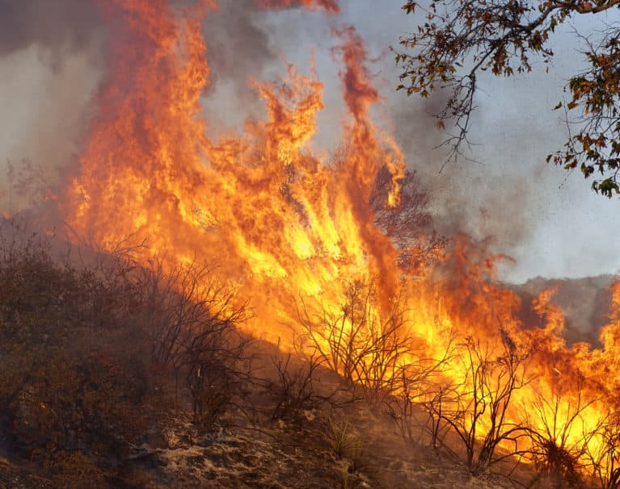
Climate Disasters and World Risk
Paulo Eduardo Balderas Howell
LinkedIn: www.linkedin.com/in/-edward-howell
Date: 24/06/2024
Notes:
Credit: Climate Change Is Fueling California's Wildfires, Scientists Say | Here & Now (wbur.org) ??

Slide 2
Objectives and Context…
Analyse Low Agriculture Economies to Identify Trends for Consideration in Climate Policy Development.
Many studies have highlighted climate change’s disproportionate effects on agrarian economies. However, markedly less is said on variables correlating low-agriculture economies with significant fatality rates….What is going wrong in states’ less reliant on specific climates (and thereby exposed to their adverse effects (e.g. distance from healthcare, exposure to wildfires).
‘Risk’ is to a very real degree, a human construct.
In addition to the obvious incentives for low agriculture economies to explore this, agrarian economies hoping to restructure their industries away from agriculture must consider these trends also.
With this emphasis on the structural contingency of climate ‘Risk’ in mind, this project explores the macro-economic and political variables most correlated with fatalities resulting from climate change, and our lack of preparation for it.

Slide 3
Refining My Study
As my research was centred on the exacerbating and mitigating factors in the fatality rates of those low agriculture economies most affected by climate change, I eliminated states reporting no human or financial impacts as I assumed this group to:
Largely represent an ideal non-replicable amalgamation of circumstances involving temperate climates; unextreme weather patterns; and strong, stable, economies.
It is beyond the scope of this study to explore such geographically blessed countries’ degrees of commercial diversification, and self-sufficiency, as each such measure is likely only possible given extremely specific contextual & geographical conditions.
Contain unreliable and incomplete data. Indeed, on further inspection, columns containing figures derived from other columns’ data, frequently contained values when their base column did not.
This is a preliminary research project aimed at inciting further discussion on the topic. As such, it places breadth of applicability at centre stage (with the potential for further refinements of focus in future projects).

Slide 4


Sources
Source1. My primary dataset was drawn from the non-profit German Watch’s Climate Risk Index. 2 factors are noteworthy here:
Only data for the year 2015 was available due to issues around public access (I had to source this dataset via an independent uploader).
The fatality figures in this dataset refer only to deaths directly resulting from climate change (e.g. heat waves, hurricanes, and floods). It therefore does not include fatalities resulting from famine or drought.
Source2. I supplemented this dataset with significant quantities of World Bank data for the years 2015-2017.
Agricultural Employment Values are ‘Modelled ILO Estimates’
The Data Cleaning
To ensure the reliability, validity, and usability of my data, I…
Standardized date formats across the dataset
Eliminated special characters from column names
Accounted for inflation in columns containing financial data by converting their values to the constant 2015 USD$ value (several poverty metrics were inextricable from this constant).
Eliminated Missing Values (NaNs) in several stages…
Given more time, I would have stratified and weighted each method accordingly.

Slide 5
Eliminating Missing Values (NaNs)
To maintain data validity, I ensured variables contained a minimum of 60% of their values (specific to the year 2015) and dropped columns in excess of this. I then adopted a 4-pronged approach to NaN handling. Time efficiently, mitigating impacts to the data’s overall integrity, and retaining local specificity.
Predictive Imputation. In variables where over ½ of the population exhibited consistent growth, I modelled the missing values based on the percentage changes for that country’s subsequent years. A Linear Regression or Time-Series Analysis may have had a higher degree of accuracy, but due to the limited time-based datapoints I prioritised simplicity.
Mean Imputation. Where no consistent trend was discernible, I imputed the average of the values for the country’s subsequent years.
K-Nearest Neighbours Imputation. In cases with insufficient data to complete either of the above 2 steps, I directly imputed the values from whichever year that country’s data was available.
Median Imputation. If no data was available for a country’s relation to a given column in any of the years covered, I imputed the columns’s median.

Slide 6
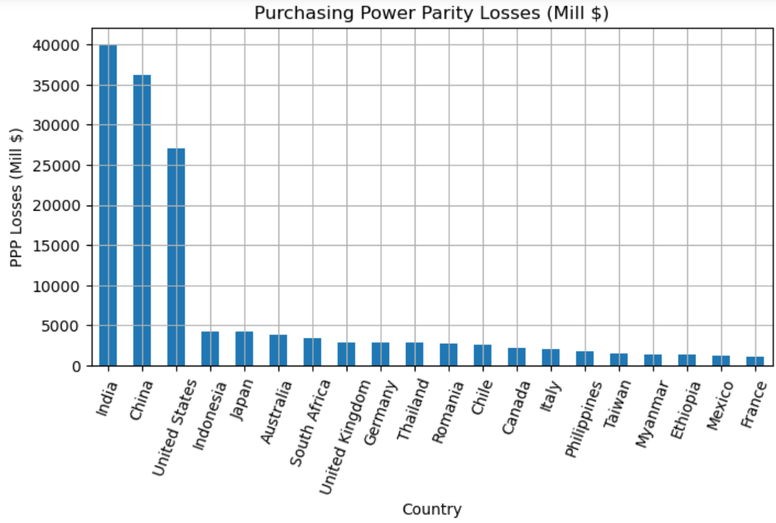
Cleaning: Outliers?
I opted to make significant use of the Median here due to the sheer size and frequency of statistical disparities in global politics. For instance, the Mean PPP losses is $1232.58m, but the Median is $92.94m.
Economics, Wealth, and Population averages will inevitably be skewed by countries like the U.S.A, Russia, and China (and in this instance India).
I did not delete them as outliers however as:
The current international system involves superpowers. This cannot be ignored or discounted as a rare, isolated event, particularly, whilst developing climate policy.
Enormous variable disparities (e.g. in wealth) and how these might relate to other variables will likely be of central concern to this study on extreme climate fatalities.
It is likely that various sizes and structures will each carry their own problems.
But if we graph the data we see that the 3rd ranked country in this regard suffered more than 5x more losses than the 4th .

Slide 7
Methodology
Interested in potential common characteristics of high fatality countries (regardless of their geographical size/population densities) I created a ‘Fatalities Index’ assigning equal weights to the columns for Fatalities/100k (Rank) and Fatalities Total (Rank) and synthesising them.
Stratified Correlations Analysis (Spearman’s Rank)
I collected the top 40 variables (/negatively) correlating with the Fatalities Index. I then filtered out any variables present in the top 40 correlation coefficients of the broader population. I used Spearman’s rank here due to the non-linear nature of its relationships (being composed of ranks).
I then complimented this stratified correlation analysis, with a visual analysis of the distributions of the data points and the gradients of their lines of best fit.
This helped me identify specific variables correlating with the high fatality rates of countries within the subgroup. i.e. I could begin identifying: what’s different and what changes at this threshold.
Limitations: Given more time, I would extend my visual exploration with a residual analysis. At present, however, my project’s primary aim is to highlight crucial areas for further research.

Slide 8
Comparative Statistical analysis
Delving deeper into the fruits of these findings, I compared the means of variables relating to these fatality correlations.
A thorough statistical analysis of subgroups’ Means was largely beyond the scope of this project. However, to begin forming a more complete picture of the variables highlighted by my correlation analysis I briefly explored differences between the central tendencies of my subset, and those excluded from it.
A more comprehensive study with more time would benefit from a systematic Means comparison of each of the 5 fatality group’s Means.
For the sake of clarity, simplicity and time efficiency, I graphed all variables with absolute mean differences greater than 30% of their combined average. A more detailed, study should consider a comparison based on the p-values derived from more rigorous significance tests (e.g. Mann-Whitney Utest).

Slide 9
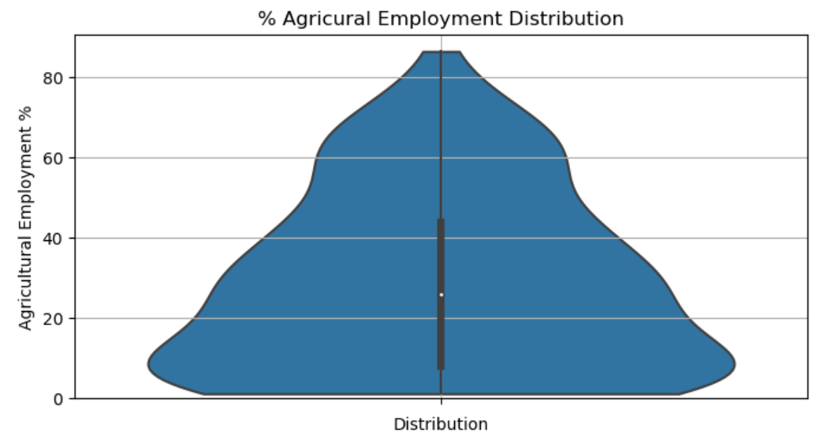
Methodology: Subgroup Analysis Agricultural Employments
Whilst I based my Agricultural Employment groupings on the population’s percentiles, I based my fatality groupings on the variable’s range. This was because aside from a couple outliers, the Agricultural employment distribution was much more densely packed, implying the difference between high and low agricultural economic reliance involved only a marginal increase in formal agrarian employment.
This made sense as most agrarian economies are only marginally made up of employed farmers; with several undocumented workers, reclusive subsistence farmers, and modern slaves to each agrarian employee.

Slide 10
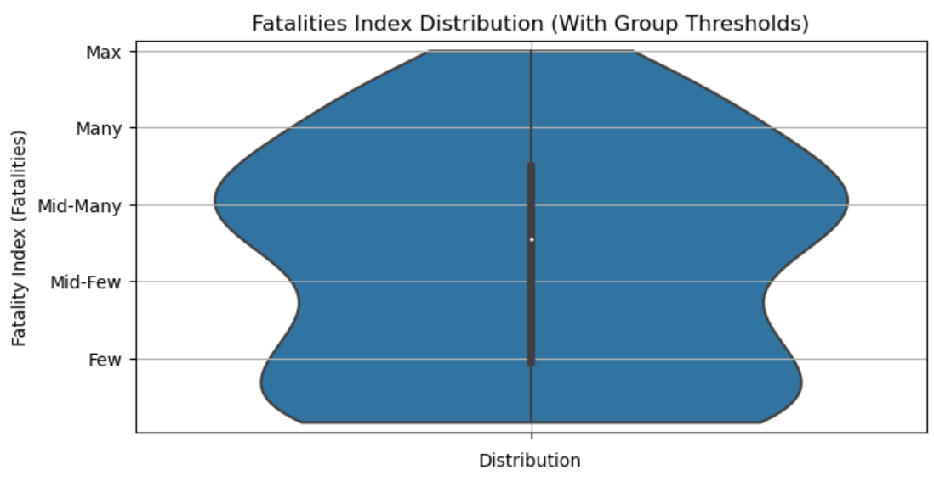
Methodology: Subgroup Analysis Fatality Groupings
Inversely my interest in the Fatalities Index was centred on whether countries frequently fell above the ‘Many Deaths’ Threshold and what changed when that threshold was reached? I wanted to broach the question, what was going wrong in the most extreme cases and why were states, less reliant on specific climates, still being dramatically affected? Could we glean anything as to the cause of the additional fatalities in this group?
This latter was largely beyond the scope of this project, but laying the groundworks for such research would require clear simple, comparable data. I was therefore more interested in having evenly spaced group thresholds, independent of the sample’s distribution (of rank combinations) but dependent on its values.

Slide 11
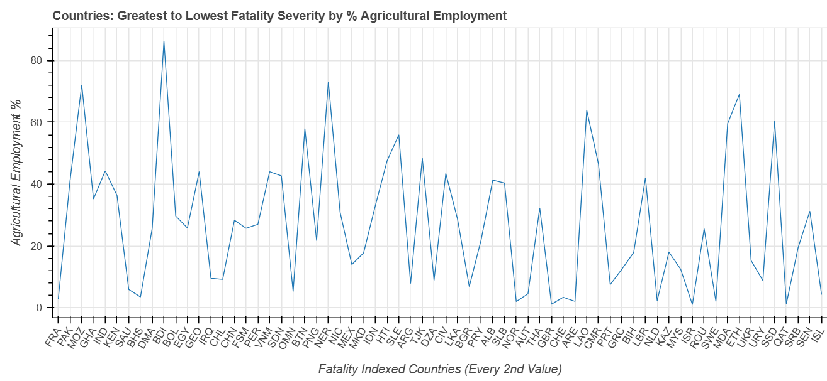
EDA: Variability
Prior to an analysis of low-agriculture economies’ fatality trends, I first explored the degree to which fatalities directly resulting from climate change, were correlated with Agriculture.
Of agriculture related variables, Agrarian Employment was the variable most correlated with direct deaths from climate change. And it was the 6th most correlated variable over-all. It should also be noted that this transcended Rural Population, and even Agricultural Land Size (in both km² and % of total).
I therefore expected Agrarian Economies to be consistently more affected than non-agrarian ones.
However there was a surprising level of variability. As you can see, this made, the broader trend more difficult to visualise.
As the correlation, was relatively weak, a future multivariate analysis of Agrarian Economies should be considered.
NB - As the correlation, was relatively weak, a future multivariate analysis of Agrarian Economies should be considered.

Slide 12
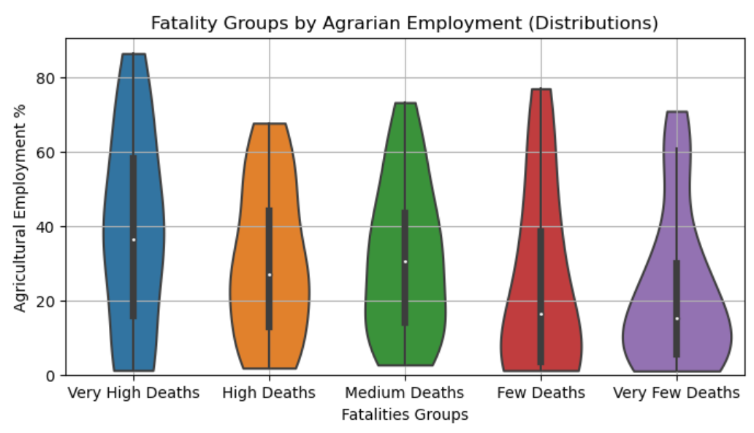
Still as suspected though
Despite the significant variation in Agrarian Employment a downward trend was noted, for although the range of each group was consistently large, their central tendencies steadily declined.
Indeed, despite the blip in the median of Medium Deaths’ agrarian employment rate, the distribution of each glyph steadily lowered (and converged)
Nevertheless, the significant levels of variability, re-emphasised the question: what is going wrong in Low-Agrariculture Economies?

Slide 13
Still as suspected though
Despite the significant variation in Agrarian Employment a downward trend was noted, for although the range of each group was consistently large, their central tendencies steadily declined.
Indeed, despite the blip in the median of Medium Deaths’ agrarian employment rate, the distribution of each glyph steadily lowered (and converged)
Nevertheless, the significant levels of variability, re-emphasised the question: what is going wrong in Low-Agrariculture Economies?

Slide 14
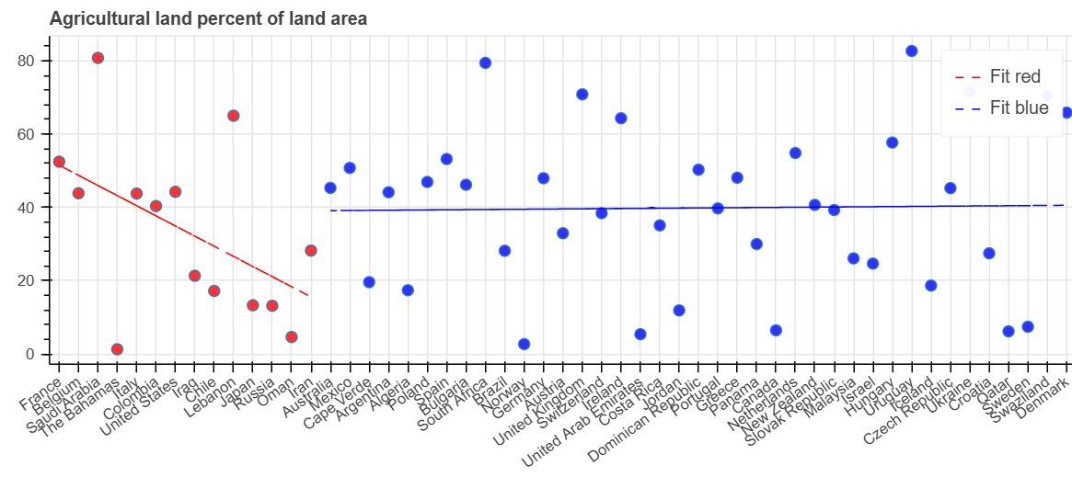
Correlations Analysis Findings: Expected
Several findings were to be expected given our initial assumption of a correlation between agriculture and climate fatalities.
Nevertheless, the visibly distinct convergence around a line of best fit (compared to the more random distributions of lower fatality countries) was noteworthy and begs a further residual analyses that is sadly beyond the scope of this brief study.
Whilst the small subgroup sample size carries the possibility of signifying false trends (/deviations) here, 3 variables stood out dramatically.
The most dramatic variations were more perplexing…

Slide 15
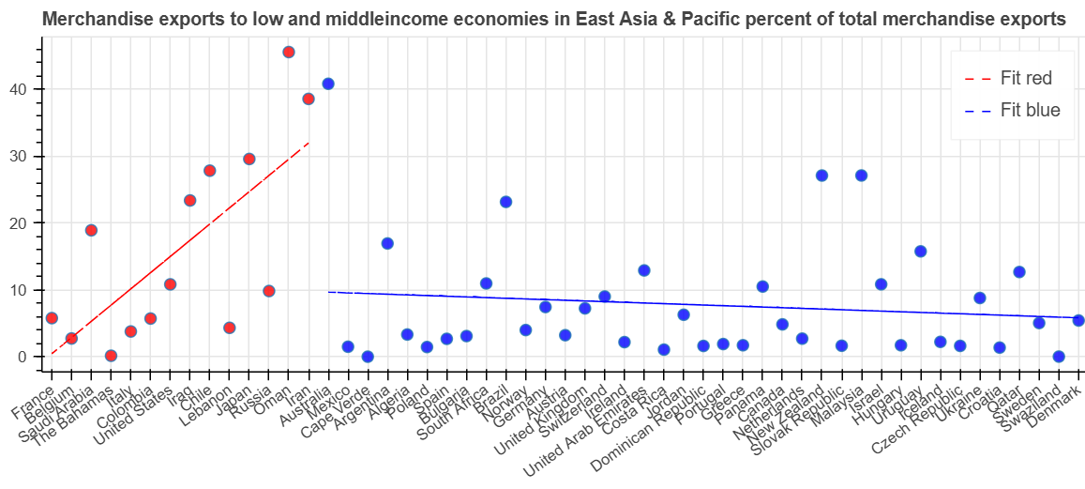
Dramatic Differences – 1
Of the variables most significantly correlated to extreme weather fatalities, 3 showed dramatic deviations from what would be expected given a consistent trend from that noted in countries with fewer fatalities.
1. Exports to Less Economically Developed Economies (LEDE) in East Asia & the Pacific.
There is a clear distinction in the variable’s relation to climate fatalities. In High Fatality countries, fewer exports to East Asia consistently corresponded to more fatalities.
Inversely, in Lower Fatality countries, almost no trend occurred beyond a slight positive correlation.

Slide 16
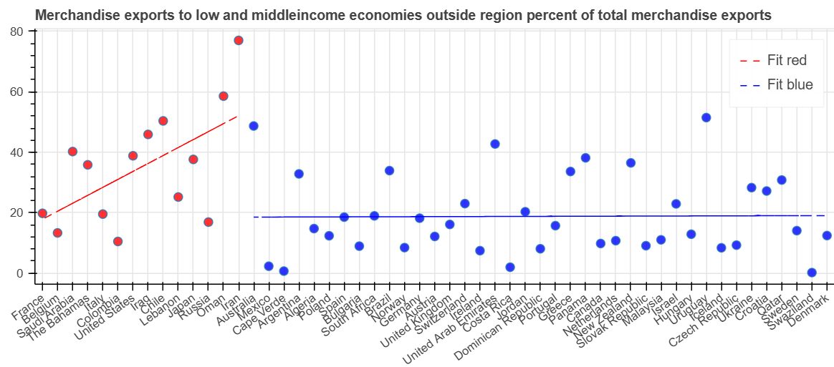
Dramatic Differences – 2
Exports to LEDE Outside the Local Region.
Exports to LEDE Outside the Exporting Country’s Local Region.
Despite the less direct linear relationship within the High Fatalities subgroup, a negative correlation remains visible. What is more interesting however, is the distribution’s divergence from the Lower Fatality group’s line of best fit.
The graph highlights a clear distinction in the groups’ central tendencies. Furthermore, if later residual analysis proves the linear relationship to be too weak to be significant, the distribution’s deviation from its initial convergence around the 20% mark is noteworthy.

Slide 17
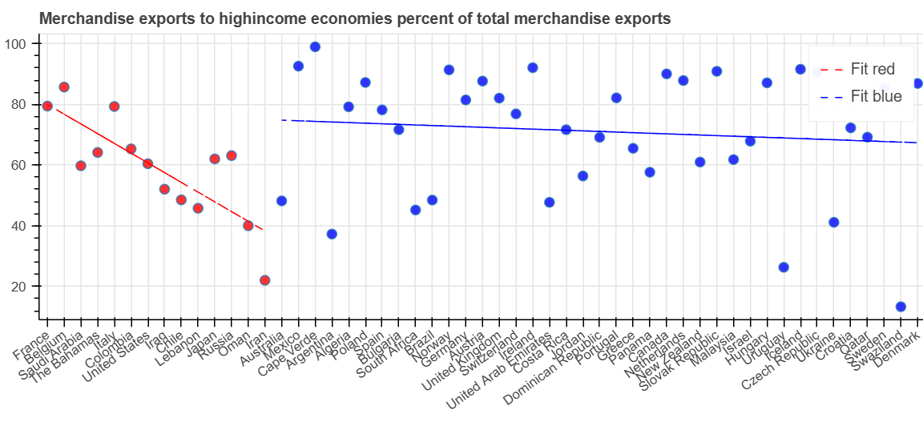
Dramatic Differences – 3
Exports to High-Income Economies.
Exports to High-Income Economies.
Here, the strong linear relationship is not only visibly distinct from that of the broader population, but, unlike in the 2 previous examples, denotes a positive correlation. This highlights that the relationship between exports and fatality rates is not simply an issue of an economies’ general production levels. Who is being sold to is relevant.
Does this imply something about the deals being struck/the bargaining positions being negotiated from? Or perhaps something about the product bought by high income countries?
The fact that this positive correlation applies only to the High-Fatalities subgroup, implies a locally specific issue. Since other state’s climate fatalities seem unrelated to these exports, it seems unlikely that the issue lies here alone.
- particularly given the range of power & wealth levels included in both groups (with Lower Fatality countries including the UAE, UK, Germany…etc).

Slide 18

Means: Correlation not Causation?
The Mean % of exports going to high-income economies from High Fatality countries was not only lower than that of Low Fatality countries (59% : 71%), but their difference was deemed too small to be statistically significant.
This further supports the implication that the central issue in this instance is related to the products being exported (more than the deals being struck).
I therefore graphed the main correlating variables, alongside any significant differences in each group’s exports means.

Slide 19
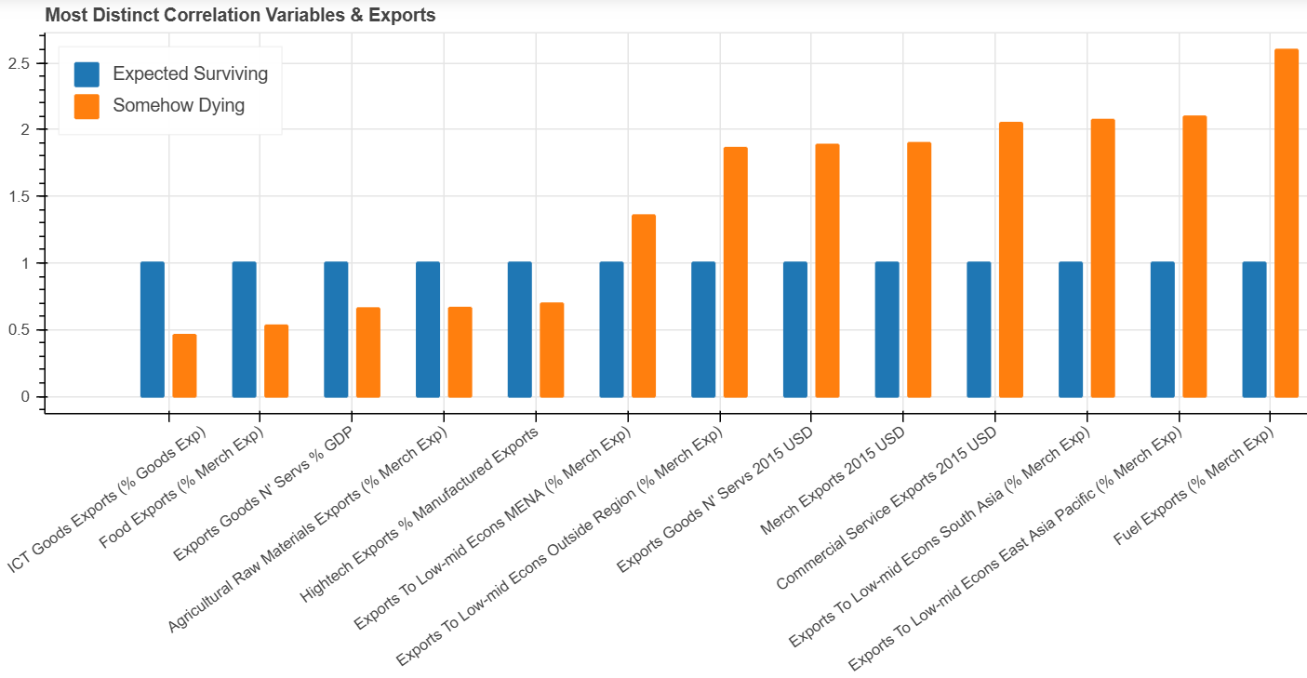
Means
NB - It is interesting that Fuel exports were not highlighted as a correlating factor, given a) the magnitude in the mean’s differences and b) the fact that the most notable correlations (Green) all highlighted the exports of the subsets’ countries, and the predominant exports of this subset are a) commercial services and b) Energy.
Here, we can see that whilst, exports make up a much smaller % of High Fatality countries’ GDPs (Blue), their sheer volume outmatches that of Lower Fatality economies, particularly in Fuel and Commercial Services (Red).

Slide 20
Discussion – To Consider
At present, it is unclear why exporting fuel would correlate to deaths resulting from extreme weather events. Therefore, one might suggest further research into:
Micro-climates resulting from oil extraction/refinement any potential correlations with acid rain or similar human influenced weather patterns.
Civil engineering: privileging certain urban spaces and correlations with new and extreme weather patterns. Has urbanisation and the construction of civil architecture around commercial service hubs made certain people vulnerable in new ways?
As these correlations are likely caused by an amalgamation of variables, further research into these areas is recommended. However, it should also be noted that Fuel exports were not explicitly listed as possessing a correlation coefficient within the top 20 correlating variables. This, combined with the significantly greater Mean ‘Exports to LEDEs’ might indicate that the actors involved are of more central importance here.

Slide 21
Discussion – To Consider
A) The exchanges in these exports. In cases where exports have been paid for with trade-offs in e.g. construction projects, the practical consequences of this must be considered. China’s Trillion$ Belt and Road initiative has involved vast infrastructure projects, around the world, often with little coordination or rushed deadlines. Combined with the factors of climate change and this could have knock on effects relating to workers’ exposure to the elements and less durable buildings. This is however, merely speculation and the actual reality of how many more workers would be exposed to the elements than usual might be debated.
B) Wealth. It is possible that the higher rates of trade with allies in South East Asia, is associated with lower greater levels of free trade. Indeed, this may be inline also with the variable ‘Exports to LEDE outside Local Region’ and with the fact that one of High Fatality economies’ primary exports is Commercial services. These countries may have prioritised commercial successes correlating with high quantities of trade with the region over certain public sector initiatives which may have resulted in increased death rates. However, Tarif rates and profit taxes were both variables in the dataset with relatively high correlation coefficients – in the top 20 correlating variables (0.51c, 0.42c). However, the limited size of the High Fatalities group, rendered the statistical significance of these correlations dubious (for more on this see Appendices). Nevertheless, more research is necessary into public sector spending, and more importantly public sector efficiency.

Slide 22
Conclusion – Causes?
Over the course of this study, several surprising trends have been noted, not least of which was the surprising number of developed, wealthy, non-agrarian economies severely suffering from the (direct) effects of climate change.
A clear trend was noted in these high-fatality countries, correlating lower export rates with higher death rates but highlighting the centrality of who one's trade partners were.
After some comparative analysis of the linear relationships, directions of correlations, and means comparisons, it emerged that (in the case of exports to high-income economies at least) who was being traded with was likely more about what was being traded.
Extending this logic to the other variables however, raised more questions than it answered. Why would exporting Fuel and Commercial services, to South East Asia and distant regions correlate with deaths as a result of extreme weather events?
Could the Fuel Variable imply something about the deals being made and their structural impacts? Forms of payment? Debt servicing?
More research is needed then as to the deals being struck in these transactions; as to ‘what’ specifically is being sold to whom; and as to potential microclimate correlations with trade in fuel (e.g. acid rain from fracking and oil extraction/refining processes?). The common sense of this last might make it a more pressing priority, however the lack of representation of this variable in the fatality correlations list might do the inverse.

Slide 23
Sources
World Bank, (2015-2024) available at: World Development Indicators | DataBank (worldbank.org) last accessed [24/06/24]
German Watch, Climate Risk Index (2017) available at: Global Climate Risk Index 2017 | Germanwatch e.V. last accessed [24/06/24]
Tools and Libraries:
Programming Languages and Libraries: Python, Pandas, NumPy,
Data Visualization Tools: Matplotlib, Seaborn, Bokeh,
Machine Learning Tools: Scikit-Learn,
General Tools: Warnings
Environment and Output: Jupyter Notebook,
Workflow Tools: Code Documentation (inline comments), Version Control (e.g., Git, GitHub)

Slide 24
Appendices (p1)
Given the predominantly extended consequences of climate change, the utility of looking at only direct deaths should be questioned. However, it might form another avenue by which to frame climate policy in immediate and comprehensible terms whilst highlighting some of it less explored areas to consider.
The variables contributing to Agrarian direct deaths, warrant further multi-variate analysis.
This research refers to the Year 2015. Whilst it is now almost a decade old, it is not so old as to be totally obsolete, particularly for the purposes of this Portfolio.
State’s least impacted by climate change tended to record their data most consistently. The effects of instability on research capacities should therefore be considered.
Future research should repeat the study with greater attention to land and population sizes. However, it should be noted that Fatalities/100k ranks by Agrarian Employment Rates showed similar levels of variability as that exhibited by the Fatalities Index (s11); graphs available in notebook.
Future Mean comparisons should explore more inverse correlations (I explored this briefly but due to time constraints more is still needed).
Eliminating all ‘unaffected’ countries will likely have skewed results somewhat. Future explorations may want to explore the differences in results without this reduction.
The small sample size may have impacted the correlation analyses. However, given the small number of countries that actually fit the criteria of this group, this is a difficult issue to resolve. Rather I would suggest doing a micro-analysis of each country, eliminating potential outliers amongst the group and conducting a multi-variate analysis on those that remain.

Slide 25
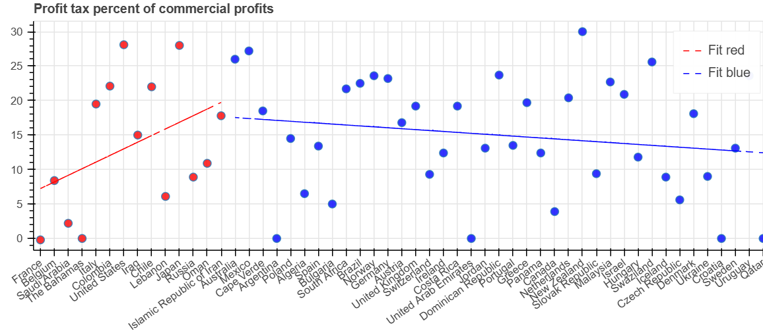
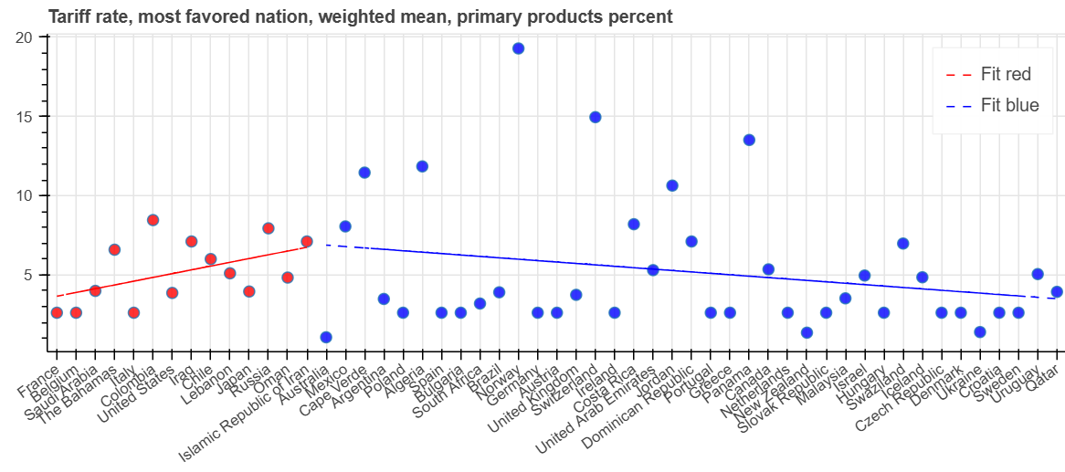
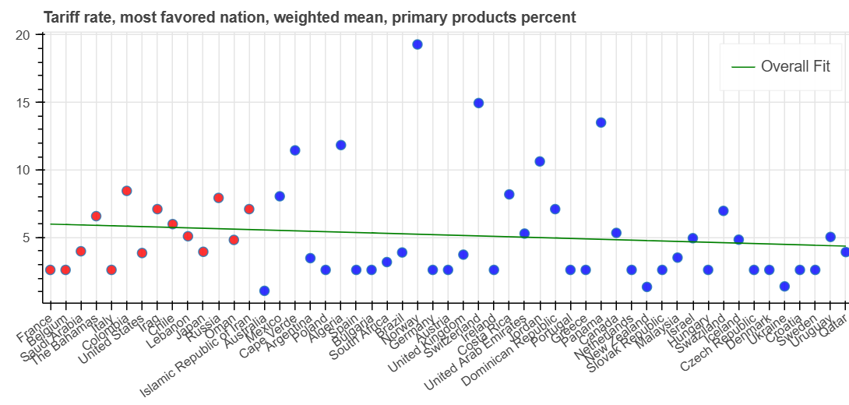
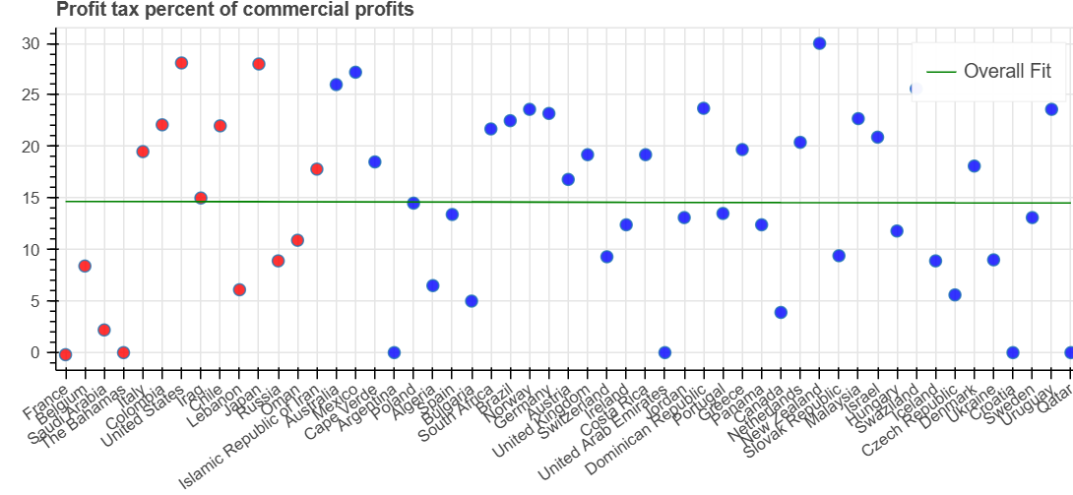
Caveats, Small Sample Difficulties
Here we can clearly see how for both Tarif Rate and Profit tax, the line of best fit, and Spearman’s correlation Coefficients can be skewed by the small subgroup size.
It may be worth noting here that the Fatality group threshold incidentally coincides with the lower quartile of low agriculture economies. Care must be taken if increasing the sample size.

